Slide 1
Plan Selection and UG Offerings in the School of Computing
moveForward(100);
First line of code written by
first American President
to write a line of code
December 2014
Yuanzhu Chen
1st Year Orientation Session, April 10, 2024

Slide 2
Content
Plan selection
School of Computing offerings
Degree plans
Honours degree
General degree
Minor
Certificate in Data Analytics

Slide 3
Plan Selection
Important: All students who have successfully completed 24 units or more MUST select a plan
o/w they will not be able to enroll in 2nd year courses during summer
When? May 27 to June 7, 2024
More info? https://www.queensu.ca/artsci/undergrad-students/plan-selection
Acceptance via
Automatic Acceptance, or
Pending List
Notes:
https://www.queensu.ca/artsci/undergrad-students/plan-selection

Slide 4
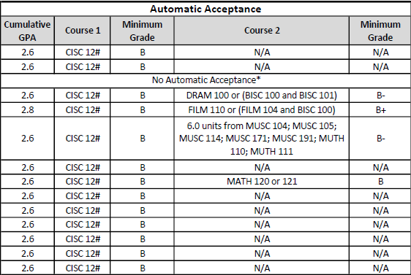
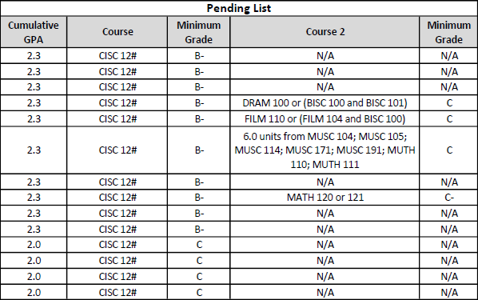
Plan Selection
Important: All students who have successfully completed 24 units or more MUST select a plan
o/w they will not be able to enroll in 2nd year courses during summer
When? May 27 to June 7, 2022
More info? https://www.queensu.ca/artsci/undergrad-students/plan-selection
Minimum requirements for
Automatic Acceptance, and
Pending List
for all Computing plans

Slide 5
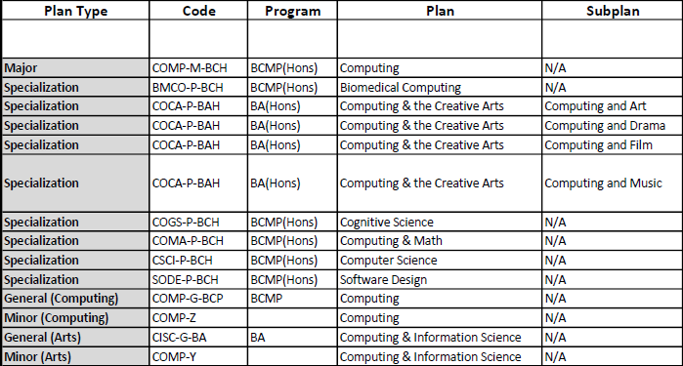
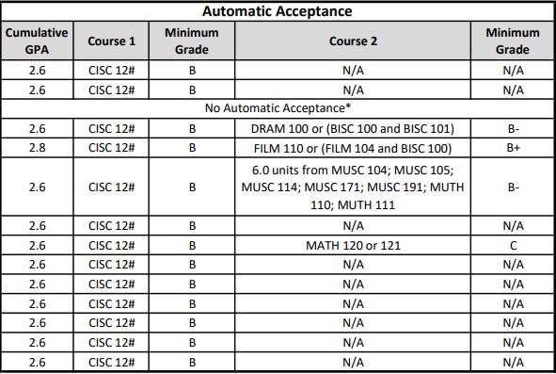
Automatic Acceptance: Minimum Requirements
Notes
* = Departments will determine automatic acceptance manually
CISC 12# = CISC 121 or CISC 124

Slide 6
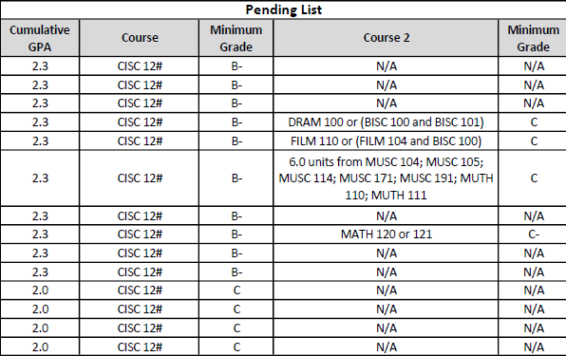
Pending List: Minimum Requirements
Notes
Getting on the pending list does not mean acceptance
CISC 12# = CISC 121 or CISC 124

Slide 7
Computing Offerings
(options)
Artificial Intelligence
Biomedical Computation
Data Analytics
Fundamental Computation
Game Development
Security
(subplans)
major
Computing Major
COMP-M/I-BCH
Computer Science
CSCI-P/I-BCH
4-year
(Honours Degree)
Software Design
SODE-P/I-BCH
Computing, Math & Analytics
COMA-P/I-BCH
specializations
Cognitive Science
COGS-P/I-BCH
Biomedical Computing
BMCO-P/I-BCH
Computing & Creative Arts
COCA-G-BAH
Plans
3-year
(General Degree)
Arts General
COMP-G-BA
Computing General
COMP-G-BCP
Computing Minor (Arts)
COMP-Y
Minors
Computing Minor (Science)
COMP-Z
Certificate
Data Analytics
DATA-C-DAT
Notes:
Difference between Major and SSP
1. combination with majors
2. number of elective courses

Slide 8
Minors
Computing Minor (Arts)
COMP-Y
Computing Minor (Science)
COMP-Z
2 Computing Minors
Arts:
33 units CISC, MATH
Science:
48 units CISC, MATH, STAT
Computing & Creative Arts
COCA-G-BAH
Cognitive Science
COGS-P/I-BCH
Biomedical Computing
BMCO-P/I-BCH
Computing, Math & Analytics
COMA-P/I-BCH
Software Design
SODE-P/I-BCH
Computer Science
CSCI-P/I-BCH
Computing Major
COMP-M/I-BCH

Slide 9
3-Year General Degrees
Arts General
COMP-G-BA
Computing General
COMP-G-BCP
2 General Degrees (90 units)
Arts:
33 units CISC, MATH
57 elective units
Computing:
48 units CISC, MATH, STAT
42 elective units
Computing & Creative Arts
COCA-G-BAH
Cognitive Science
COGS-P/I-BCH
Biomedical Computing
BMCO-P/I-BCH
Computing, Math & Analytics
COMA-P/I-BCH
Software Design
SODE-P/I-BCH
Computer Science
CSCI-P/I-BCH
Computing Major
COMP-M/I-BCH

Slide 10
Arts General
COMP-G-BA
Summary
Bachelor of Computing (Honours)
Extremely flexible
Not an SSP, can be combined with any Minor
Choose from 6 different option lists
Units
Core (42.0 units): CISC, STAT
Supporting (12.0 units): CISC, MATH
Option (18.0 units):
i) Theory & Applications
ii) Biomedical Computation
iii) Data Analytics
iv) Artificial Intelligence
v) Game Design
vi) Security
Computing General
COMP-G-BCP
Computing & Creative Arts
COCA-G-BAH
Cognitive Science
COGS-P/I-BCH
Biomedical Computing
BMCO-P/I-BCH
Computing, Math & Analytics
COMA-P/I-BCH
Software Design
SODE-P/I-BCH
Computer Science
CSCI-P/I-BCH
Computing Major
COMP-M/I-BCH

Slide 11
Arts General
COMP-G-BA
Summary
Bachelor of Computing (Honours)
Subject of Specialization
→ cannot be combined with a Minor
CIPS accredited; for more info on CIPS, see
https://www.cs.queensu.ca/students/undergraduate/faq/accredit.html
Lots of flexibility
Units
Core (54 units): CISC, MATH, STAT
Option (48 units)
one of
i) Theory & Applications
ii) Biomedical Computation
iii) Data Analytics
iv) Artificial Intelligence
v) Game Design
outside computing (30 units)
Elective (18 units)
Computing General
COMP-G-BCP
Computing & Creative Arts
COCA-G-BAH
Cognitive Science
COGS-P/I-BCH
Biomedical Computing
BMCO-P/I-BCH
Computing, Math & Analytics
COMA-P/I-BCH
Software Design
SODE-P/I-BCH
Computer Science
CSCI-P/I-BCH
vi) Security
Computing Major
COMP-M/I-BCH

Slide 12
Arts General
COMP-G-BA
Summary
Bachelor of Computing (Honours)
Subject of Specialization
→ cannot be combined with a Minor
CIPS accredited; for more info on CIPS, see
https://www.cs.queensu.ca/students/undergraduate/faq/accredit.html
Units
Core (69 units): CISC, MATH, STAT
Option (39 units)
CISC (12 units)
Writing, Commerce (6 units)
Humanities, Social Sciences (3 units)
Outside computing etc (18 units)
Elective (12 units)
Computing General
COMP-G-BCP
Computing & Creative Arts
COCA-G-BAH
Cognitive Science
COGS-P/I-BCH
Biomedical Computing
BMCO-P/I-BCH
Computing, Math & Analytics
COMA-P/I-BCH
Software Design
SODE-P/I-BCH
Computer Science
CSCI-P/I-BCH
Computing Major
COMP-M/I-BCH

Slide 13
Arts General
COMP-G-BA
Summary
Bachelor of Computing (Honours)
Subject of Specialization
→ cannot be combined with a Minor
Units
Core (72 units): CISC, MATH, STAT
Option (12 units)
Electives (36 units)
Option courses
Communications & Coding
Data Analysis
e.g., 271, 371, 372, 451, 473 (all CISC)
Theory in Computer Science
e.g., 422, 462, 465, 466, 467 (all CISC)
Discrete Math & Optimization
Computing General
COMP-G-BCP
Computing & Creative Arts
COCA-G-BAH
Cognitive Science
COGS-P/I-BCH
Biomedical Computing
BMCO-P/I-BCH
Computing, Math & Analytics
COMA-P/I-BCH
Software Design
SODE-P/I-BCH
Computer Science
CSCI-P/I-BCH
Computing Major
COMP-M/I-BCH

Slide 14
Arts General
COMP-G-BA
Summary
Computing and BIOL, CHEM & BCHEM
Bachelor of Computing (Honours)
Subject of Specialization
→ cannot be combined with a Minor
Units
Core (96 units)
CISC, MATH, STAT
BIOL, CHEM, BCHM (24 units)
Option (9 units)
Electives (15 units)
Computing General
COMP-G-BCP
Computing & Creative Arts
COCA-G-BAH
Cognitive Science
COGS-P/I-BCH
Biomedical Computing
BMCO-P/I-BCH
Computing, Math & Analytics
COMA-P/I-BCH
Software Design
SODE-P/I-BCH
Computer Science
CSCI-P/I-BCH
Computing Major
COMP-M/I-BCH

Slide 15
Arts General
COMP-G-BA
Summary
Computing and 2 of LING, PHIL or PSYC
Bachelor of Computing (Honours)
Subject of Specialization
→ cannot be combined with a Minor
Units
Core (51 units)
CISC, COGS, Math/Stats
Option (45 units)
30 units from 2 of LING, PHIL or PSYC
15 units from option lists
Electives (24 units)
Computing General
COMP-G-BCP
Computing & Creative Arts
COCA-G-BAH
Cognitive Science
COGS-P/I-BCH
Biomedical Computing
BMCO-P/I-BCH
Computing, Math & Analytics
COMA-P/I-BCH
Software Design
SODE-P/I-BCH
Computer Science
CSCI-P/I-BCH
Computing Major
COMP-M/I-BCH

Slide 16
Arts General
COMP-G-BA
Summary
Computing and one of Art, Drama, Film or Music
Bachelor of Arts (Honours)
→ no internship option
Subject of Specialization (SSP)
→ cannot be combined with a minor
COAR: No automatic acceptance
Units
Core (45 units): CISC, MATH
Sub-plan (39 units): one of:
Art, Drama, Film, or Music
Electives (36 units)
Computing General
COMP-G-BCP
Computing & Creative Arts
COCA-G-BAH
Cognitive Science
COGS-P/I-BCH
Biomedical Computing
BMCO-P/I-BCH
Computing, Math & Analytics
COMA-P/I-BCH
Software Design
SODE-P/I-BCH
Computer Science
CSCI-P/I-BCH
Computing Major
COMP-M/I-BCH

Slide 17
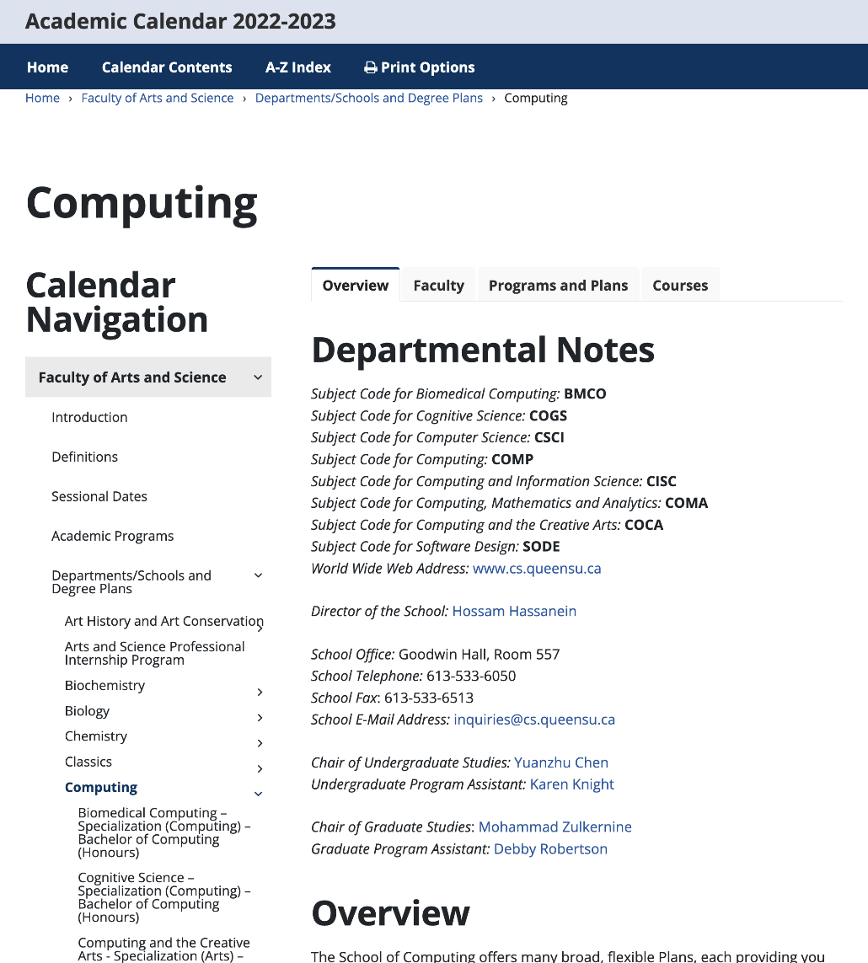
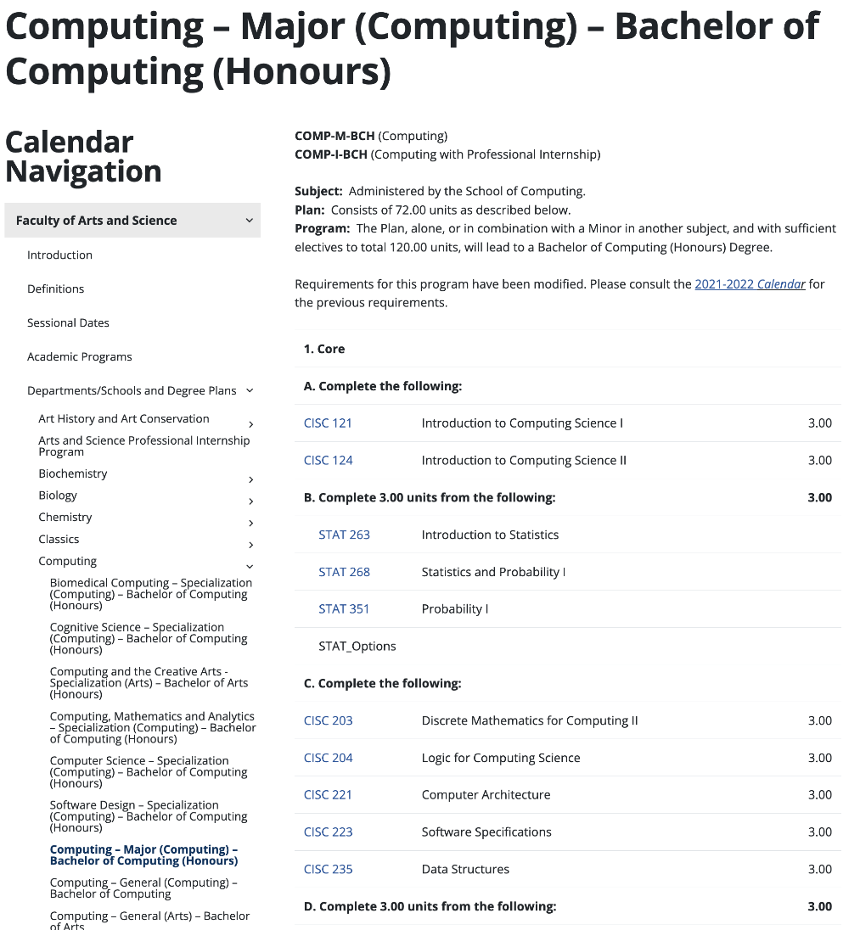
Complete, Official Descriptions of Plans
For the full descriptions of these plans, please see document ‘Academic Plans, Schools, Departments’ in the Arts and Science eCalendar at
https://www.queensu.ca/academic-calendar/arts-science/
e.g., for COMP:
Notes:
https://www.queensu.ca/academic-calendar/arts-science/

Slide 18
Professional Internship
Arts General
COMP-G-BA
Computing General
COMP-G-BCP
12-16 months
~$40K/year salary
Need to secure position yourself
Queen’s Career Services can help
Eligibility
Bachelor of Computing (BCH) plan
GPA ≥ 1.90
· 108 units completed towards plan
Could go after 2nd year
Computing & Creative Arts
COCA-G-BAH
Cognitive Science
COGS-P/I-BCH
Biomedical Computing
BMCO-P/I-BCH
Computing, Math & Analytics
COMA-P/I-BCH
Software Design
SODE-P/I-BCH
Computer Science
CSCI-P/I-BCH
Computing Major
COMP-M/I-BCH

Slide 19
Certificate in Data Analytics
5 courses
4 required courses
Intro to Statistics (STAT 263) or STAT_OPTIONS
Data Analytics (CISC 251)
Advanced Data Analytics (CISC 351, exclusion with CISC 371, CISC 372)
Topics in Data Analytics (CISC 451)
plus 1 course from
CISC 432, CISC 181, STAT 269, STAT 351, STAT 466, SOCY 284, SOCY 309, PSYC 301, BIOL 343, EMPR 370, …
2 of these courses can also be reused
to satisfy Computing plan requirements
Open to students
not in Analytics option of CSCI, COMP or COMA, i.e., not taking CISC 371 or CISC 372
More info on
https://www.queensu.ca/artsci/programs-and-degrees/certificates
https://www.queensu.ca/artsci/node/682/mid/956/credit-certificates
Notes:
https://www.queensu.ca/artsci/programs-and-degrees/certificates
https://www.queensu.ca/artsci/node/682/mid/956/credit-certificates

Slide 20
Sources of Information
Arts & Science Faculty: Plan Selection
https://www.queensu.ca/artsci/undergrad-students/plan-selection
Arts & Science Faculty: Academic Advising https://www.queensu.ca/artsci/undergrad-students/pass-academic-advising
School of Computing Advising: advising@cs.queensu.ca
Undergraduate Program Assistants: Karen Knight, Erin Gunsinger
Undergraduate Chair: Yuanzhu Chen
First-year Student Coordinator: Wendy Powley
Undergraduate Program Officer: Samir Mohammad
Notes:
https://www.queensu.ca/artsci/undergrad-students/plan-selection
https://www.queensu.ca/artsci/undergrad-students/pass-academic-advising
advising@cs.queensu.ca Please use your Queen’s email and include your student number!

